Slide 1
MHA Screening
Madeline Halpern

Slide 2
Overview
Screening Statistics
Advanced Analysis
How can you use screening?
Screening to Supports

Slide 3
Screening Promotes Recovery
People who screen regularly are:
More attuned to their symptoms
More knowledgeable about their conditions
Better able to communicate with their provider
Able to recognize improvement early in treatment
More aware of the warning signs of relapse
Better able to self-manage their illness.
Notes:
Jurgen – from Collaborative Care Study

Slide 4
More Screening = Better Healthcare
Screening in primary care perceived as helpful 93% of the time
PCPs 3 times more likely to recognize mental illness symptoms and follow up
Post-screening treatment changes were made 40% of the time
Positive benefits persist one year later
Sources: Christensen, et al, 2005; Pignone et al, 2002; O’Connor et al, 2009; Duffy et al, 2009.
Notes:
When positive screening results were given during a primary care visit, doctors were over 3 times more likely to recognize the symptoms of mental illness and to plan to follow up with the patient.
Treatment following screening has been shown to reduce symptoms of mental illness and the positive effects of treatment are still seen a year later.
When people screen in a setting with provider, routine use of screenings (like PHQ-9) was perceived as helpful in 93 % of sessions.
Treatment changes attributed to PHQ-9 score were made in 40 % of sessions.
Christensen, K. S., Toft, T., Frostholm, L., Ørnbøl, E., Fink, P., & Olesen, F. (2005). Screening for common mental disorders: who will benefit? Results from a randomised clinical trial. Family practice, 22(4), 428-434.
6 Pignone, M. P., Gaynes, B. N., Rushton, J. L., Burchell, C. M., Orleans, C. T., Mulrow, C. D., & Lohr, K. N. (2002). Screening for depression in adults: a summary of the evidence for the US Preventive Services Task Force. Annals of internal medicine, 136(10), 765-776.
7 O’Connor, E. A., Whitlock, E. P., Beil, T. L., & Gaynes, B. N. (2009). Screening for depression in adult patients in primary care settings: a systematic evidence review. Annals of Internal Medicine, 151(11), 793-803.
Duffy, et al. Systematic use of patient-rated depression severity monitoring. Is it helpful and feasible in clinical psychiatry? Psychiatric Services 2009; 59:1148-1154.

Slide 5
MHA Screening Results Create Value
Big Data: New Insights into Help-Seeking, Not-Yet-Diagnosed Populations.
Planning and Evaluation: Special URLs for Population Tracking.
Anticipating the Needs of Individuals and Delivering Targeted Services.

Slide 6
Basic Screening Statistics

Slide 7


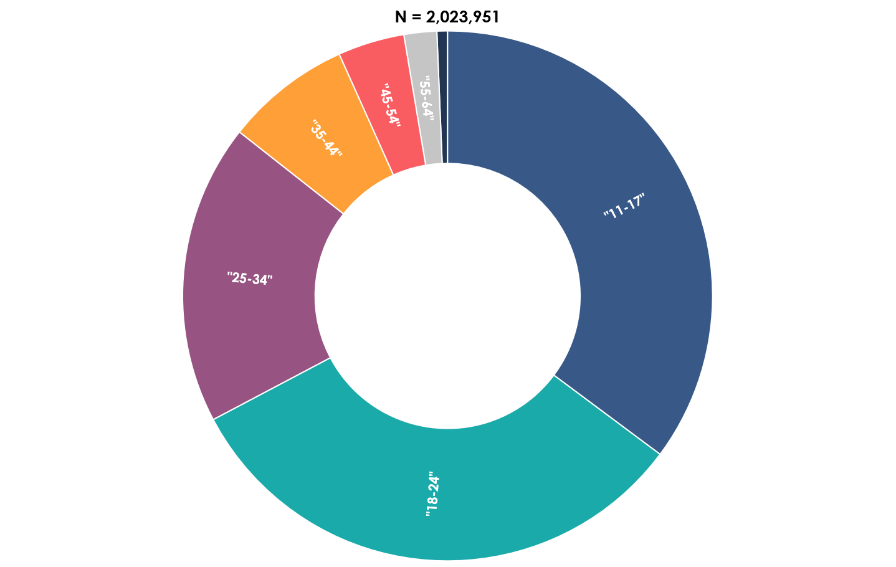
www.mhascreening.org 2015-2017
75%
25%

Slide 8
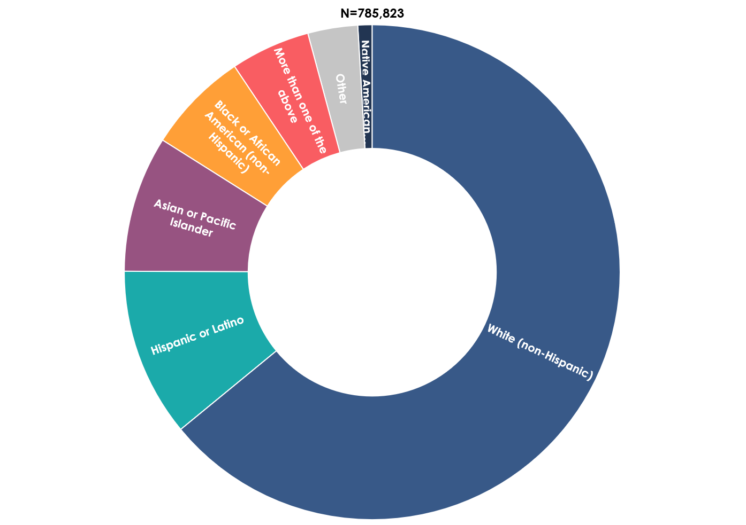
Race/Ethnicity 2017

Slide 9
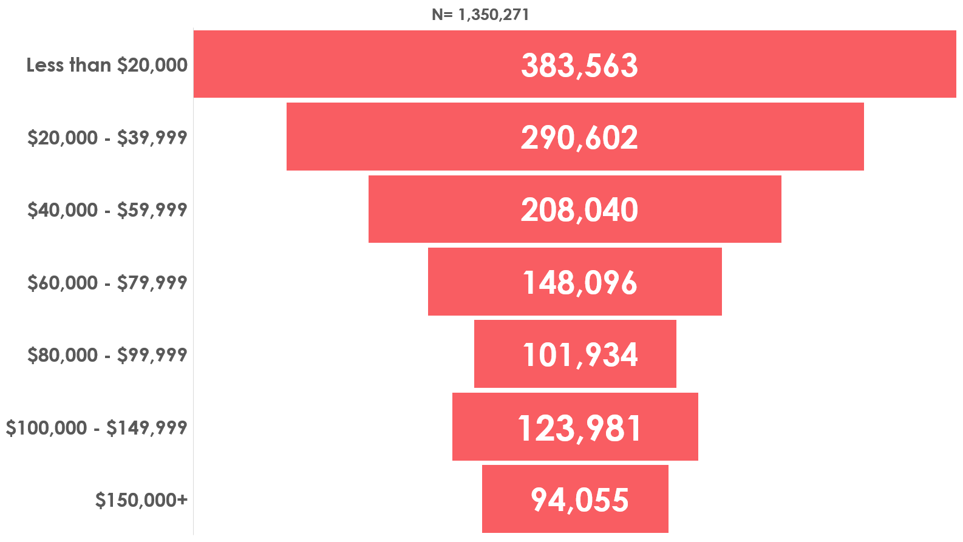
MHA Screeners by Income, 2015-2017

Slide 10
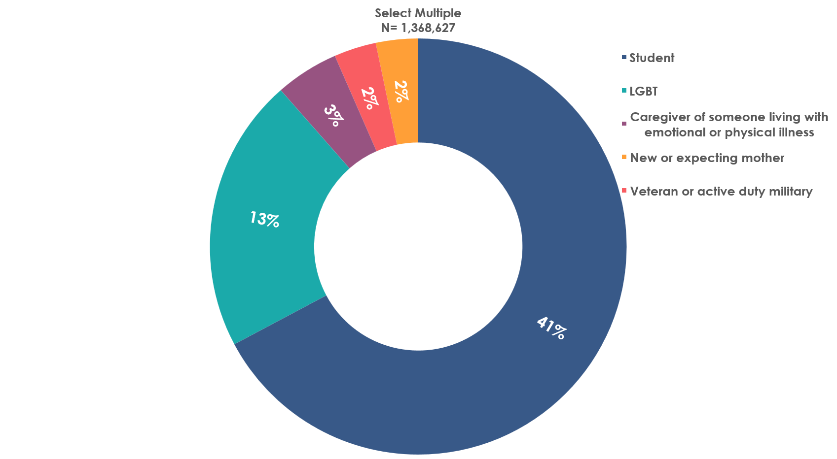
Special Populations, 2015-2017

Slide 11
MHA Screener Results, 2015-2017

Slide 12
MHA Screeners: Next Steps, 2017

Slide 13
Advanced Analysis

Slide 14
Screening Results: Men More Likely to do Nothing

Slide 15
Caregivers are Most Frequently Positive for Eating Disorder

Slide 16
Race/Ethnicity: Blacks Most Likely to Do Something, 2017
Percent Saying “No Next Steps” with Results

Slide 17
Native American and Multiracial Individuals Most Positive or Moderate to Severe, 2017

Slide 18
Young (<25) Women More Likely to have Positive Result

Slide 19
Vets/Active Duty: Most Worried About Depression, Bipolar, Psychosis, 2017
81% Positive

Slide 20
MHA Screeners With Chronic Conditions Who Are Positive For Mental Illness
Source: MHA Online Screening Data, 2017

Slide 21
At Risk for Psychosis, 2017
72% of psychosis screeners scored at risk for psychosis.
26% of individuals over 45 have household incomes over $80,000 versus 16% of those under 45.
29% report arthritis or chronic pain as a comorbid health condition.
More than any other options, individuals say they’re planning on taking no next step or discussing the results with another person (29% for both).

Slide 22
LGBT, 2017
Compared to the national average LGBT Youth are:
more likely to take the Youth and Psychosis Screen.
81% screen positive.
75% identify as students.
80% identify as female.
less likely to discuss the results
(25% vs 28%)
more interested in doing nothing
(30% vs 33%)

Slide 23
Millennials
In 2017, MHA had nearly 1.1 million screens.
Millennials made up half of all screeners who reported an age (397,140 screens).
Compared to the national average millennials are:
More likely to find treatment
(22% vs 18%)
More likely to take a next step
(75% vs 70%)

Slide 24
New or Expecting Mothers, 2017
Compared to the national average new or expecting mothers are:
More likely to screen likely substance use
(91% vs 78%)
Most interested in discussing the results with someone
(36% vs 28%)
More likely to find treatment
(27% vs 18%)
More likely to have comorbid health problems
(22% vs 13%)

Slide 25
Severe Depression, 2017
Older depression screeners: more likely to be male, white than younger cohort
55% of individuals with severe depression report household incomes under $40,000 per year
18% of those age 55+ identify as caregivers
9% of severely depressed adults and 16% of all severely depressed people report another health condition
58% of those reporting another health condition were under 25
68% of those over 65 report a comorbid condition

Slide 26
Veterans, 2017
20% identify as a student
10% identify as LGBT
7% identify as caregiver of someone living with emotional or physical illness.
4% identify as new or expecting mother
31% report a co-morbid health conditions
More likely to discuss the results with someone
(33% v. 28%)
Slightly more interested in finding treatment
(20% vs 18%)

Slide 27
Screening to Supports Basics

Slide 28
What’s New with Screening
New Name: Screening to Supports
Content and Resources After Screens
Different Demographic Questions

Slide 29
MHA Screening by Condition
Depression Screen PHQ-9
Parent Screen PSC
Eating Disorder Screen SWED
Anxiety Screen GAD-7
Bipolar Screen MDQ
Psychosis Screen Ultra-High Risk PQ-B
PTSD Screen PC-PTSD
Youth Screen PSC-YR
Alcohol or Substance Use Screen CAGE-AID

Slide 30



MHA Screening-to-Supports (S2S)
Information and Education
DIY: Self-Help Tools
Referral to Care and Services
Engagement with People Like Me (Peers)

Slide 31
S2S: New Pathways to Customized Support
S2S looks forward, not backward.
S2S promotes action B4Stage4.
S2S is customer-friendly.
S2S anticipates your future needs.
S2S connects help-seeking people to services earlier than ever before.
No cost for screening or customized result.
Consumer ratings used to judge value of content.
S2S delivers content you want.

Slide 32
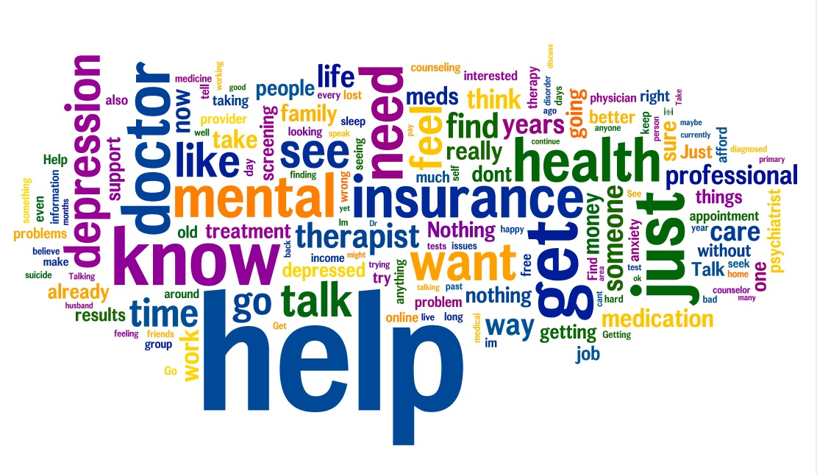
What All Screeners Want

Slide 33
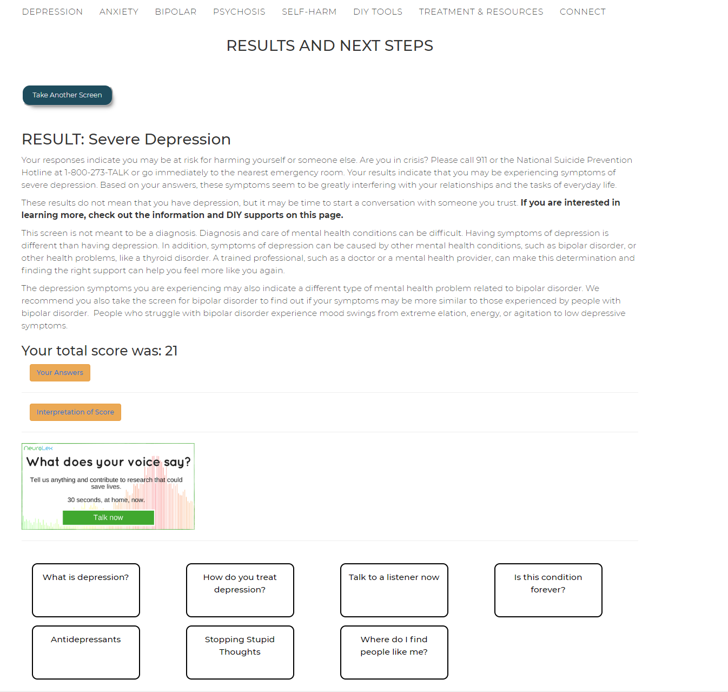
S2S:Results

Slide 34
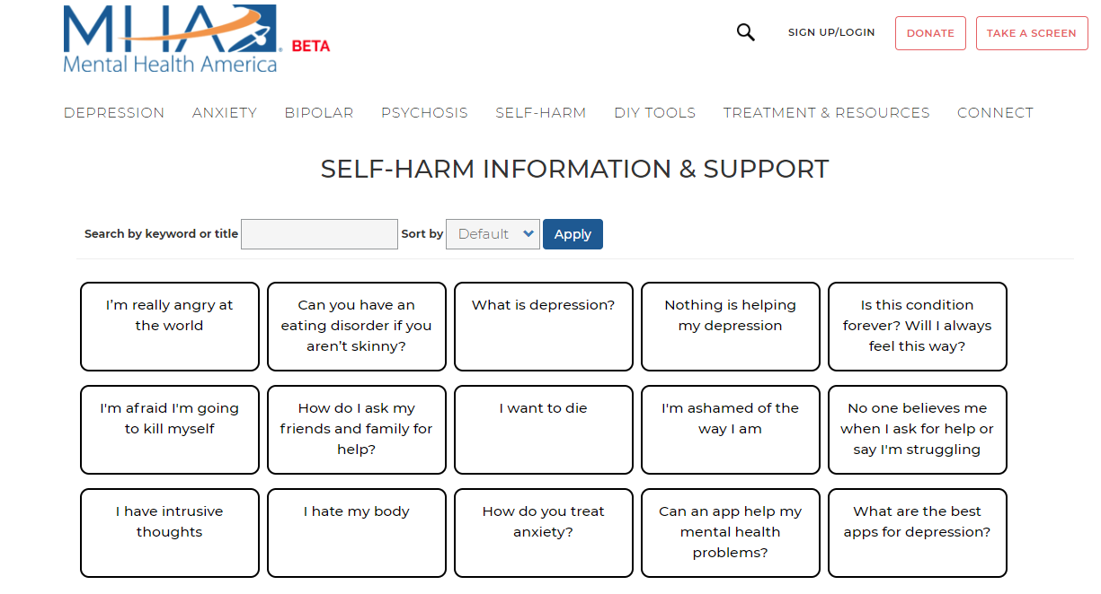
S2S: Self Harm

Slide 35
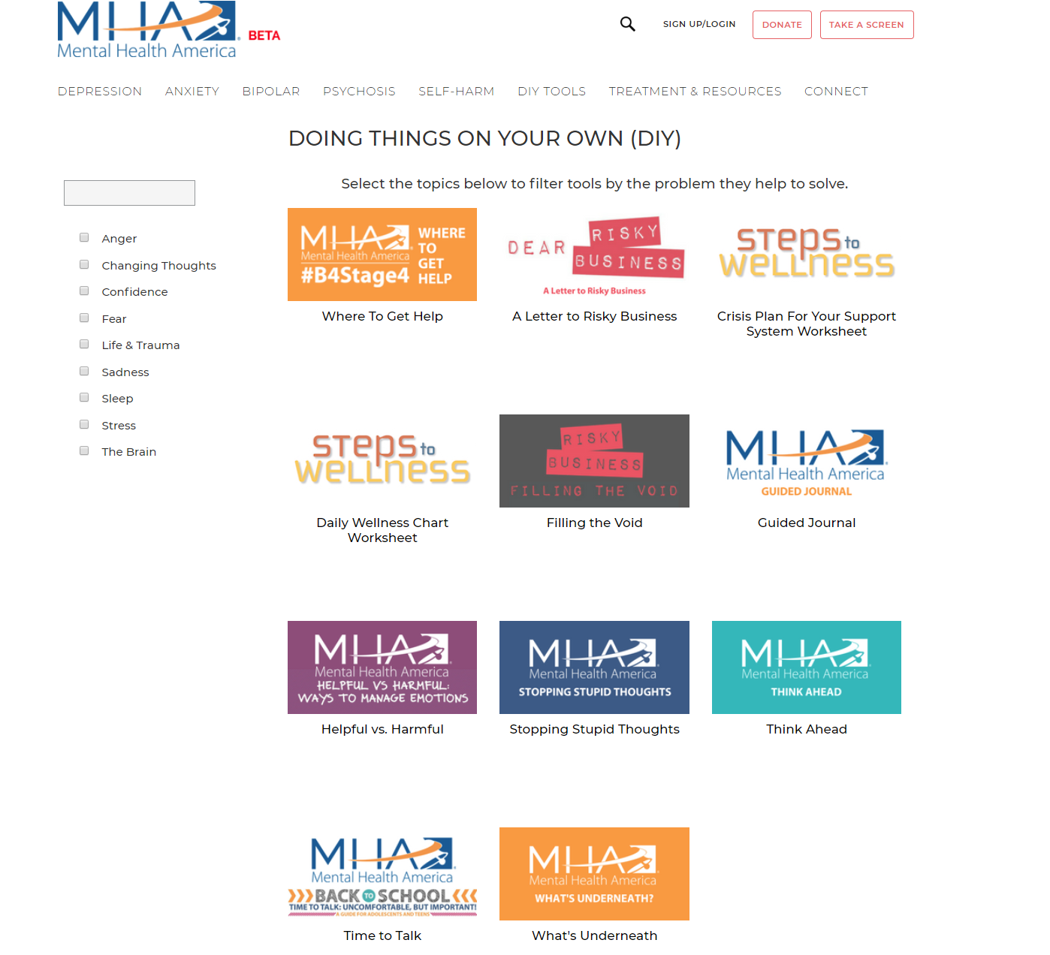
S2S: DIY Tools

Slide 36
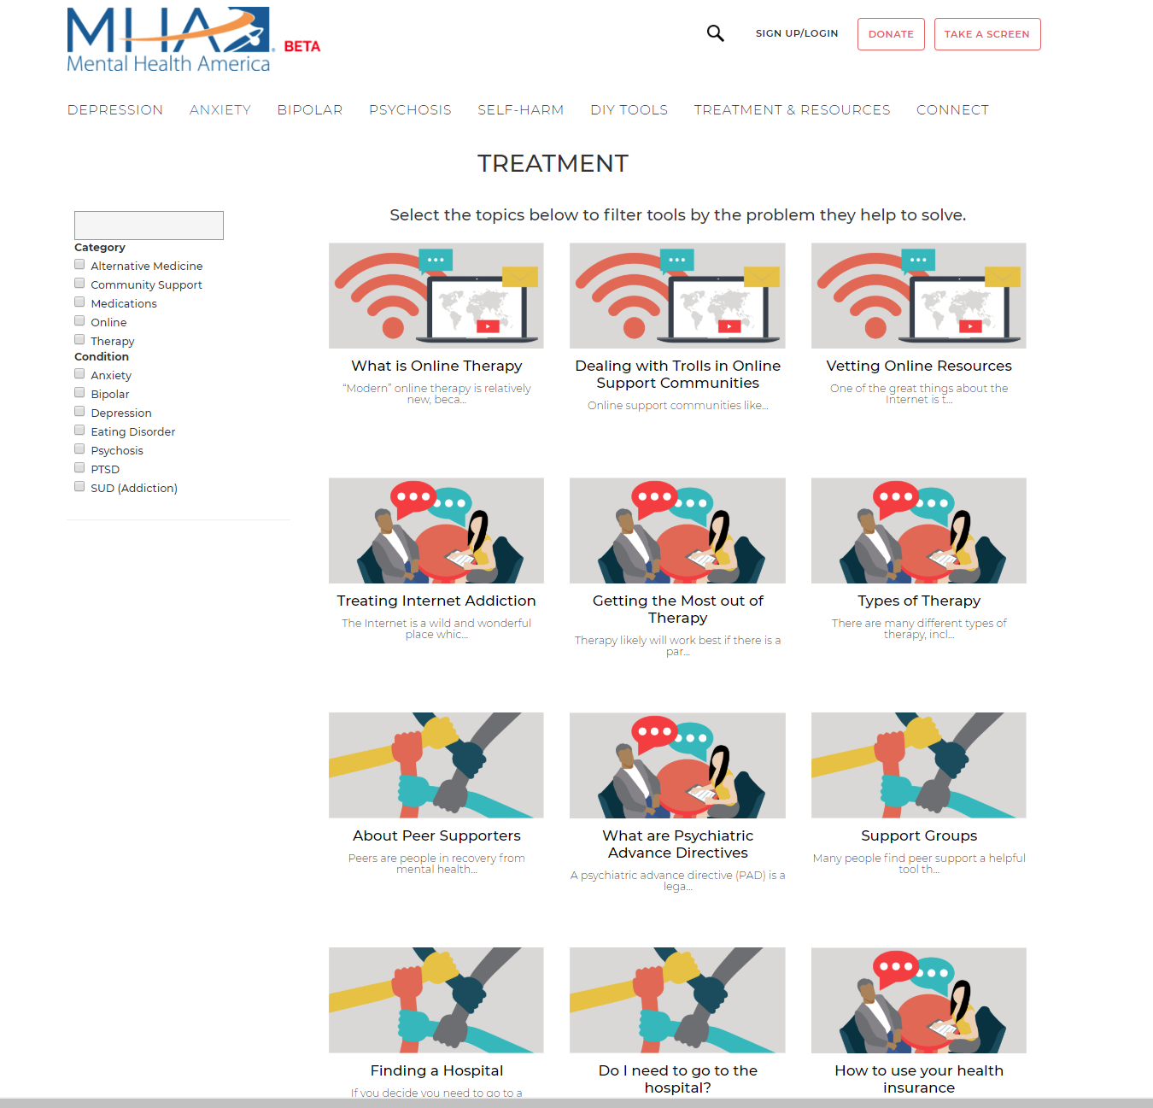
S2S: Treatment
S2S:

Slide 37
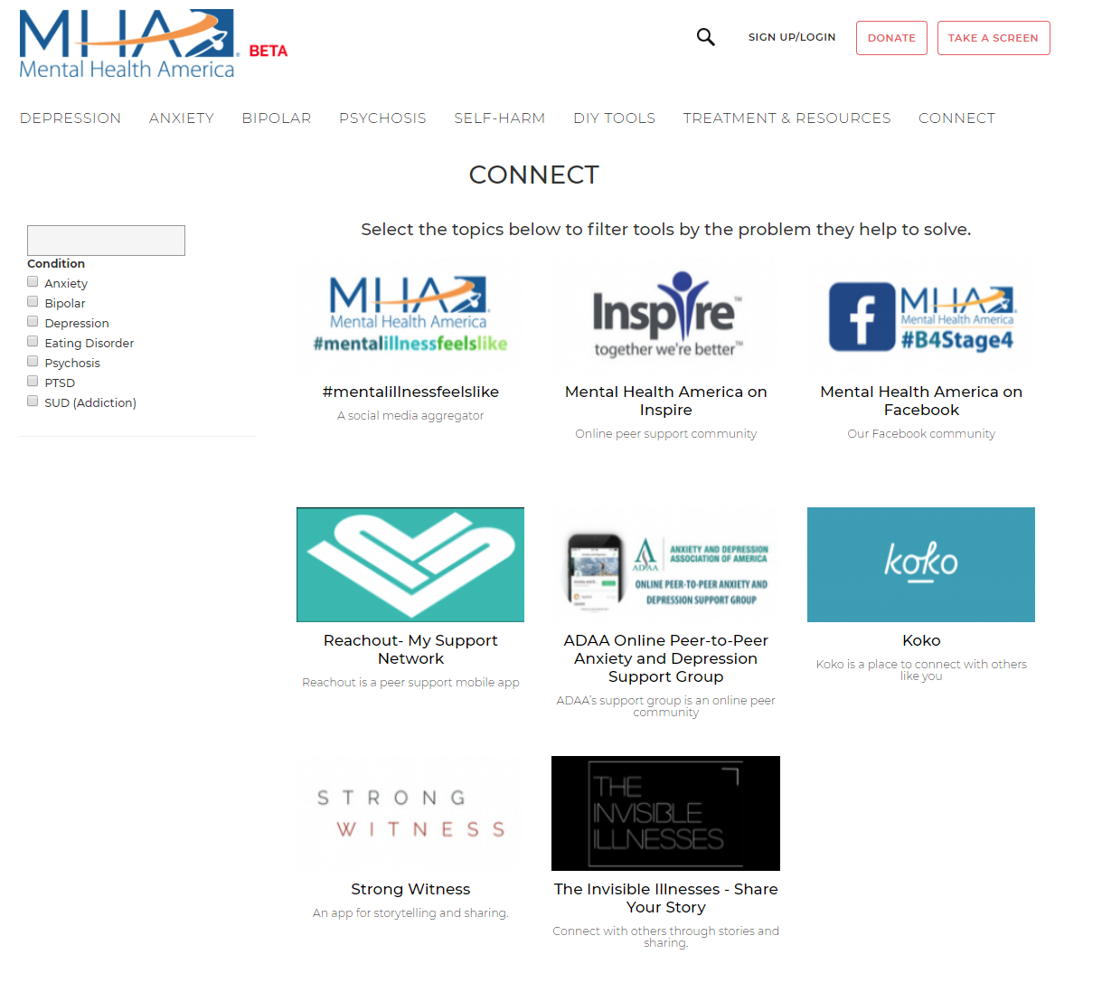
S2S: Connect

Slide 38
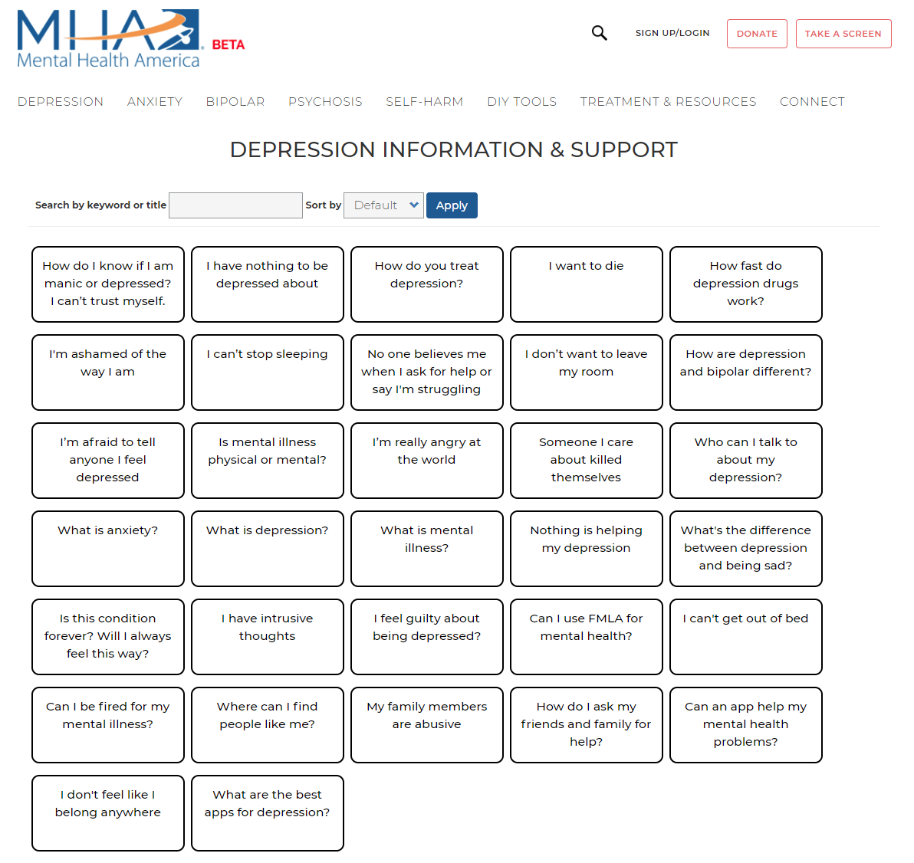
S2S: Condition Pages

Slide 39
S2S: The Role of Partners
Each domain populated with MHA resources and partner resources and services (“supports”)
“Supports” criteria:
expressed needs of the screening population
evidence of effectiveness
cost-benefit
interest in partnering with MHA
Supports will be rated by users, most useful/most popular will gain preference.

Slide 40
How can you use MHA Screening

Slide 41
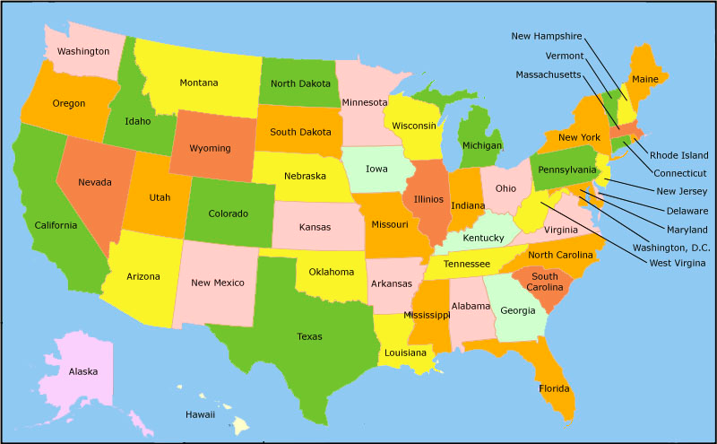
MHA Screening
Partners | Number
Affiliates | 53
Academic | 8
Corporate/Nonprofit | 14

Slide 42
Common Uses
Grant Applications
Infographics
Needs Assessments
Targeted Programs
Public Education Campaigns
Program Evaluation

Slide 43
How to collect your data
Referral URL
Free
Doesn’t require the user do anything
Zip Codes
User entered
Need to know all zips in area covered
Free
May get people from other areas
Know they came from your site
May come from any site

Slide 44
What changes can the data show
Demographics vary by state to reflect changes in those populations
Screens taken vary by region
Local requests for help

Slide 45
Madeline Halpern
mhalpern@mentalhealthamerica.net
703-837-3367

